Slide 1
Pengenalan Foto KTP
Kelompok 3 | Kuis 2 | PCVK

Slide 2
01
02
Kenalan
03
04
Alvian Nur Firdaus
Febrian Dani Ritonga
2141720022
2141720070
Devi Andini
Naresh Pratista
2141720189
2141720057

Slide 3
05
Kenalan
Zahra Annisa Wahono
2141720

Slide 4
Pre-processing
Grayscale, Gaussian Blur, Thresholding

Slide 5

Grayscale

Slide 6

Gaussian Blur

Slide 7

Thresholding

Slide 8
Localization
Contours, DetectMultiScale

Slide 9
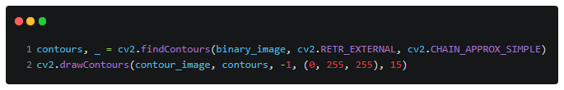
Contours

Slide 10
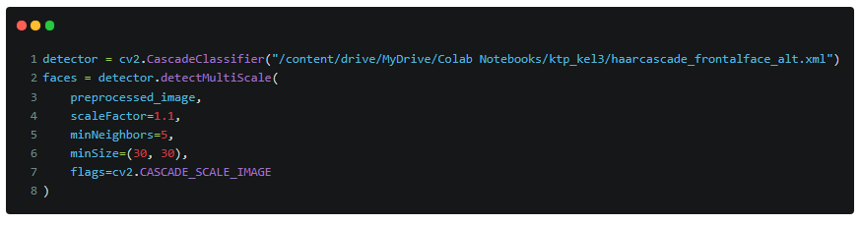
Detect
MultiScale

Slide 11
Segmentation
max(), resize()

Slide 12
Our company
01
You could enter a subtitle here if you need it

Slide 13
Pengenalan
Testing & Predict Model

Slide 14
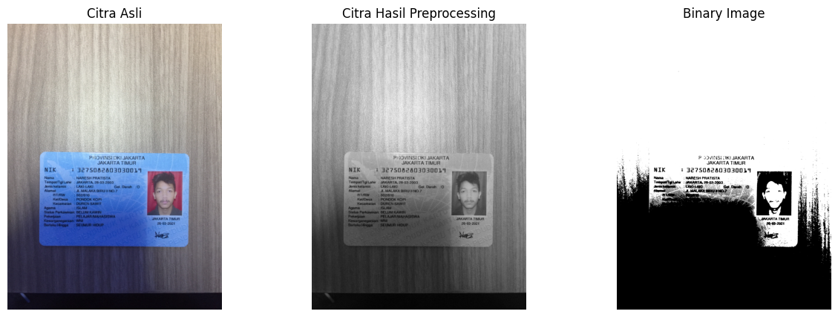
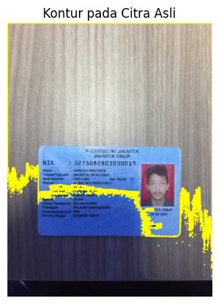
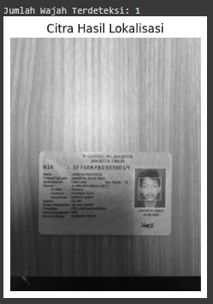
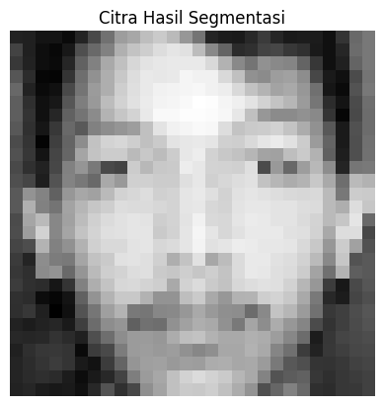
Hasil Testing
Naresh
Saturn
Saturn is a gas giant and has several rings

Slide 15
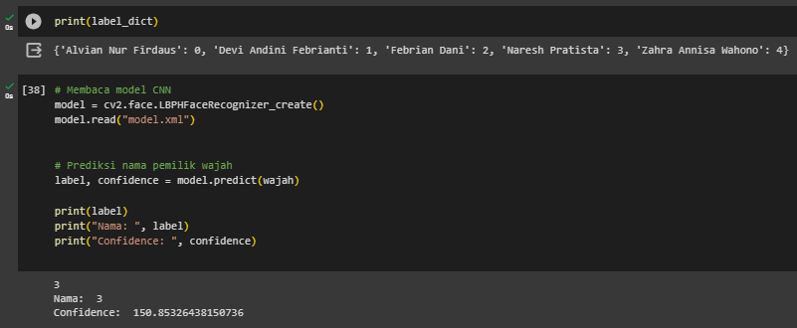
Hasil Predict Naresh

Slide 16
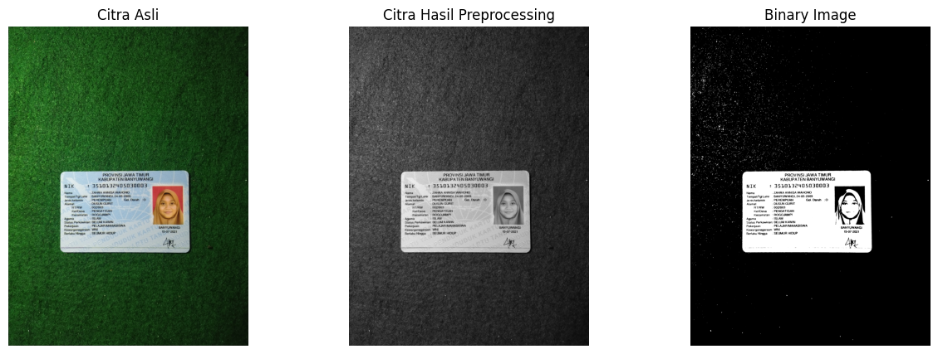
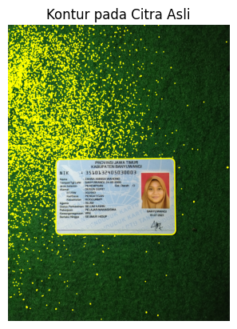
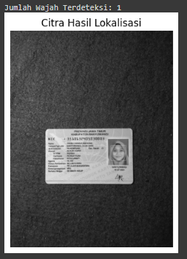
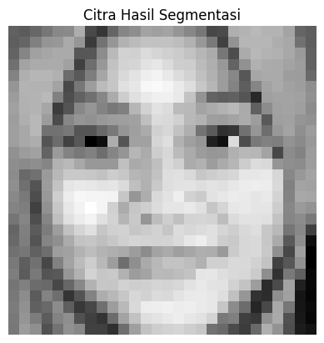
Hasil Testing
Zahra

Slide 17
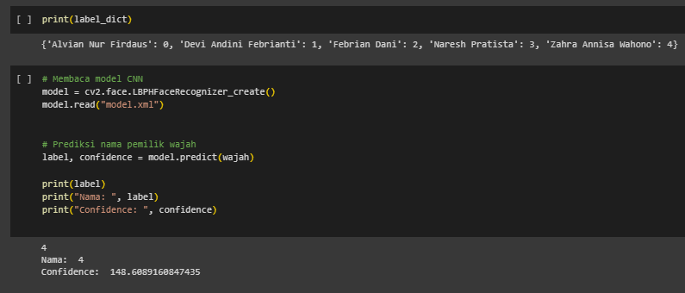
Hasil Predict Zahra

Slide 18
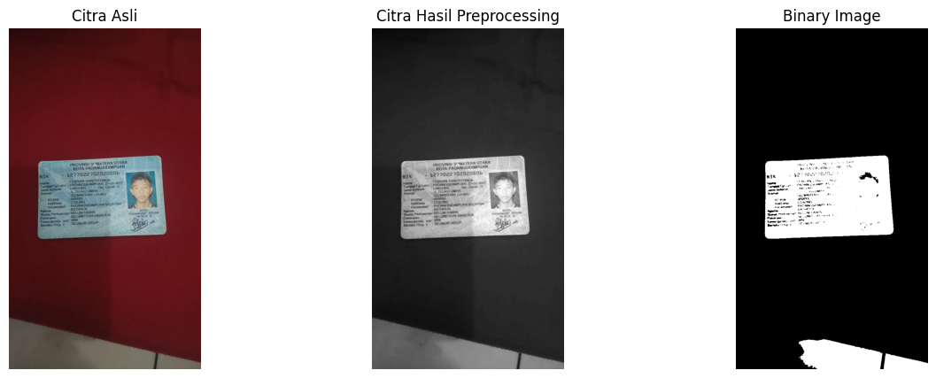
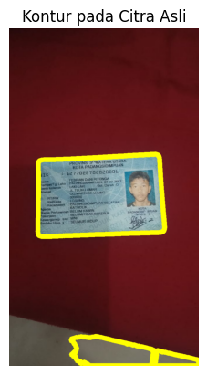
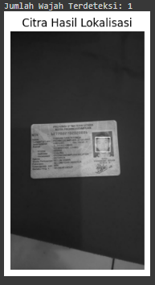
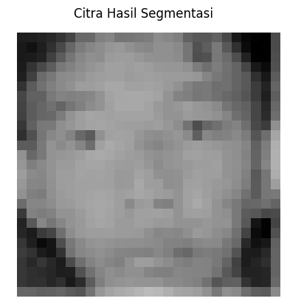
Hasil Testing
Dani

Slide 19
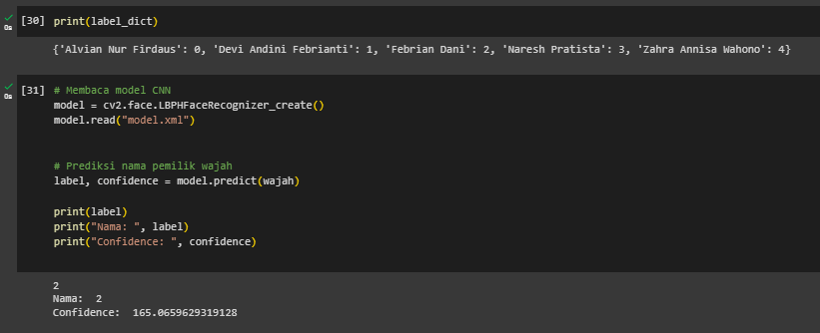
Hasil Predict Dani

Slide 20
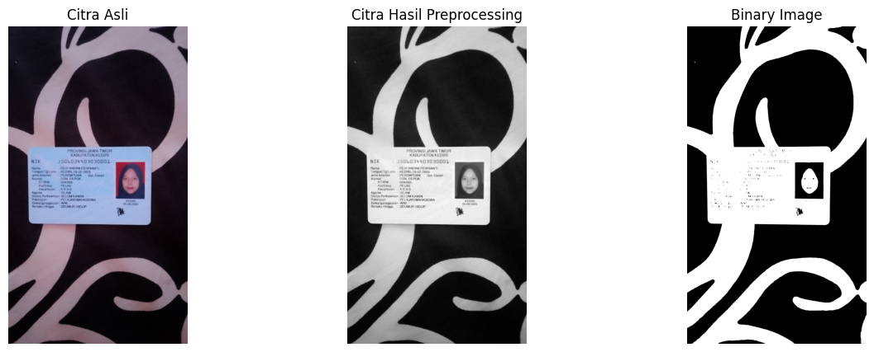
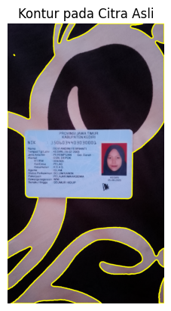
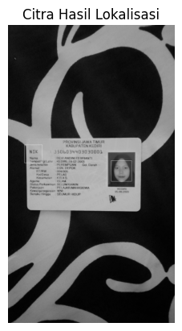
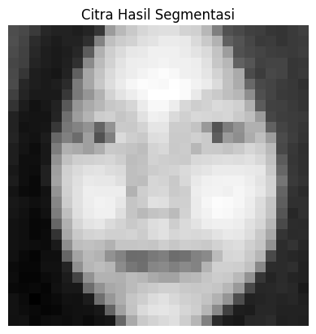
Hasil Testing
Devi

Slide 21

Hasil Predict Devi

Slide 22
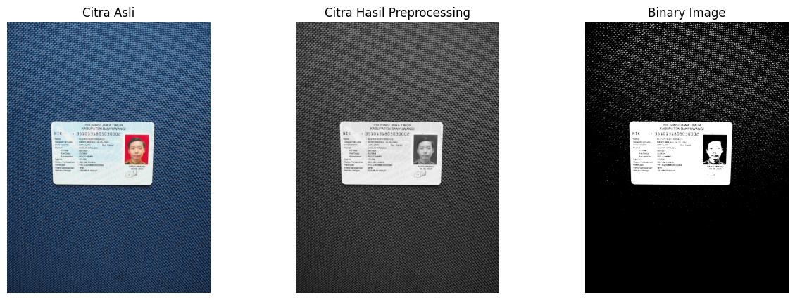
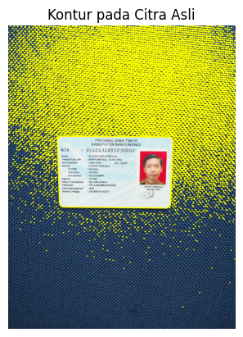
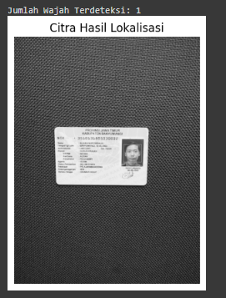
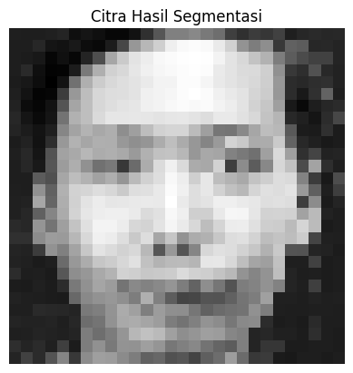
Hasil Testing
Alvian

Slide 23
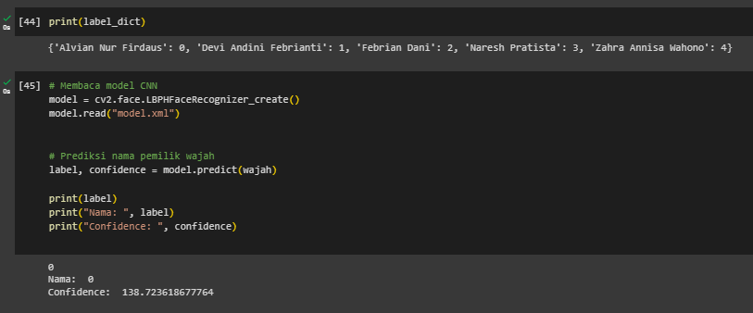
Hasil Predict Alvian

Slide 24
Terima Kasih

